Slide 1
Machine Learning and Deep Learning approach in IDS
Presented by: - Shubham Kumar
Supervisor:- Dr. Manas Khatua

Slide 2
Abstract
Due to Increase in network size, currently network security is biggest concert more than ever.
In this project we will first see about what are the solutions available to detect Intrusions in the networks.
Then we will see why we need AI technology in securing networks and what are the ML models available to secure networks.
We will evaluate some ML models and try to see which model is best.
Then, we will see Need of Deep Learning over Machine learning and review of various Deep Learning models proposed for IDS.
A Comparative analysis of Deep Learning model (Multilayer Perceptron).
Challenges in implementing ML and DL based IDS

Slide 3
Introduction
Due to advancements in internet and information technology size of networks is increasing, which is making networks more and more vulnerable to Intrusions.
Firewall, antivirus software and IDS are some example of tools that are used to secure Networks.
IDS – Intrusion detection Systems
IDS – Continuously monitors host and network traffic to detect any suspicious behavior (Intrusions) in the traffic that violates security policy of network and report the activity to admin.

Slide 4
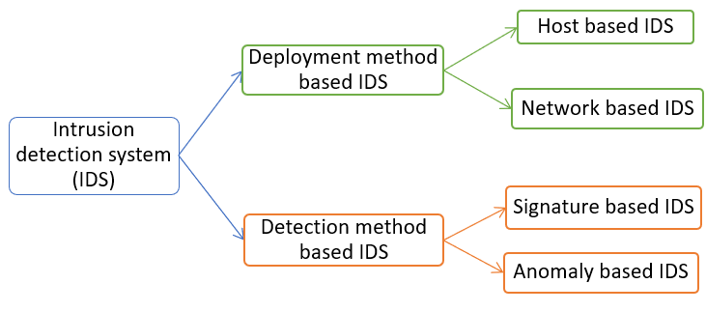
Classification of IDS

Slide 5
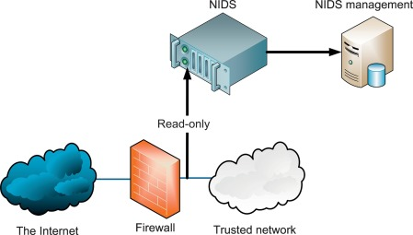
Example - Implementation of NIDS

Slide 6
Limitations of traditional IDS
Real attacks are often far less in number than false detection in traditional IDS.
Network suffers from noise and it increases false alarm rate.
Signature method-based IDS can only detect known attacks they are not much useful against new attacks. Due to above reason, they need software updates frequently.
Anomaly method-based IDS can only detect deviation from normal behavior which limits the variety of attacks that they can detect.
AI models can learn without human intervention and can be used to differentiate Normal and Intrusion traffic.

Slide 7
Related work
Many traditional methods use signature and anomaly-based methods, but now many researchers are focusing on ML and DL based IDS.
Hongyu Liu and Bo Lang survey of ML and DL methods in IDS.
Zeeshan Ahmad, Adnan Khan, Cheah Shiang, and Farhan Ahmad: study of ML and DL approaches in IDS.
KDD Dataset- used in KDDCUP contest of 1999.
Outside the Closed World: On Using Machine Learning For Network Intrusion Detection- Robin Sommer and Vern Paxson

Slide 8
Machine Learning(ML) in IDS
Machine learning (ML) algorithms gives computer models capability to learn from experience and improve upon them without explicit programming
ML models learn from observations or training data and predict the output for given input.
It will be better method in IDS. Models can learn to detect new intrusions automatically.
Supervised ML Algorithms
Unsupervised ML algorithms

Slide 9
ML algorithms in IDS
Decision tree
K-Nearest Neighbour (KNN)
Support vector machine
Clustering – Unsupervised algorithm
Naïve Bayes
Linear Regression (LR)
Artificial neural network (ANN)
Ensemble methods

Slide 10
Evaluation of Some ML Algorithms
Used KDD Dataset to train models and test models.
KDD Dataset has data with total 22 types of attacks spread into 4 classes of attack – DOS, U2R, R2L, PROBE and one class for normal data.
4898430 different data instances in dataset.
Randomly chosen 90% data to train and 10% for testing for ML algorithm.

Slide 11
Dataset Attacks instances
Attack class | Attack Name | Instances
DOS | SMURF | 2807886
 | NEPTUNE | 1072017
 | BACK | 2203
 | POD | 264
 | TEARDROP | 979
 | LAND | 21
U2R | Buffer Overflow | 30
 | Load Module | 9
 | PERL | 3
 | Rootkit | 10
Normal | - | 972780
Attack class​ | Attack Name​ | Instances​
R2L | FTP Write | 8
 | Guess Password | 53
 | IMAP | 12​
 | Multihop | 7
 | PHF | 4​
 | SPY​ | 2​
 | Warez client | 1020
 | Warez master | 20
PROBE | IPSWEEP | 12481
 | NMAP​ | 2316
 | PORTSWEEP | 10413
 | SATAN | 15892

Slide 12
Evaluation metrics
Confusion matrix
Accuracy
Precision
Recall
F-measure

Slide 13
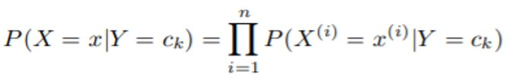
ML algorithms used for analysis
KNN – Clustering based unsupervised algorithm. Cluster training data into K-clusters based on distance between two datapoints.
Decision Trees (DTs) are a non-parametric supervised learning method used for classification and regression. The goal is to create a model that predicts the value of a target variable by learning simple decision rules inferred from the data features.
Random Forest - It is an ensemble method type classifier. It combines many classifiers to create many trees on any random subset of data and then combines the total votes of each tree to give class of the test data.
Naïve Bayes - These type of algorithm is based on the idea of conditional probability. Probability calculated according to this formula-

Slide 14
Evaluation of KNN Algorithm
Unsupervised algorithm so can-not use evaluation metrics directly.
Some Conclusion from clusters obtained after result:
On both Cluster size 5 and 2, most of the data is clustered into single cluster while training.
On testing most of the data map into single cluster.
This can be due to very small difference between distances in the data points.
Some feature selection algorithm can influence the results.

Slide 15
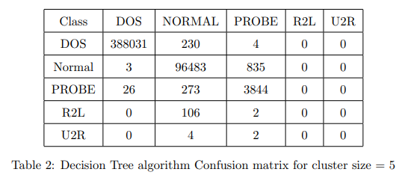
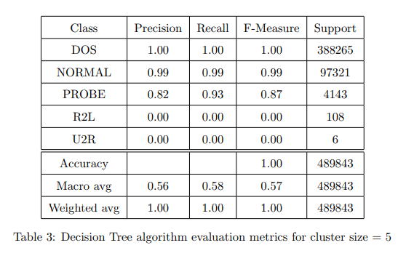
Evaluation of Decision Tree algorithm (5 classes)

Slide 16
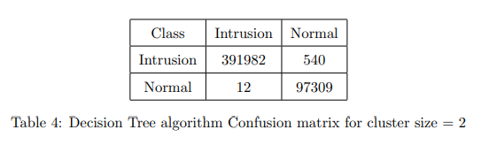
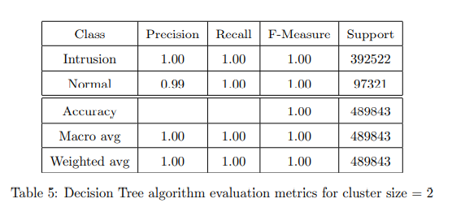
Evaluation of Decision Tree algorithm (2classes)

Slide 17
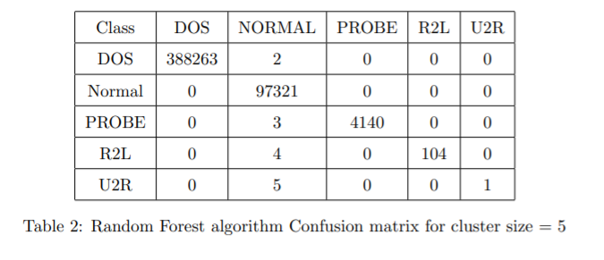
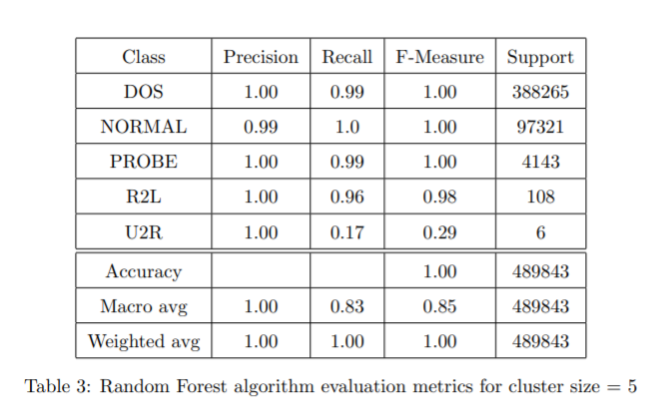
Evaluation of Random Forest algorithm 5 classes

Slide 18
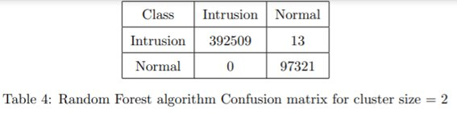
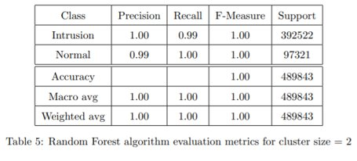
Evaluation of Random Forest algorithm (2 classes)

Slide 19
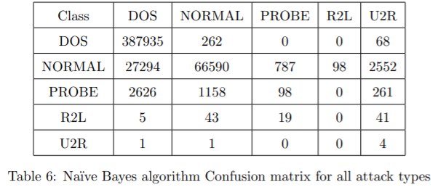
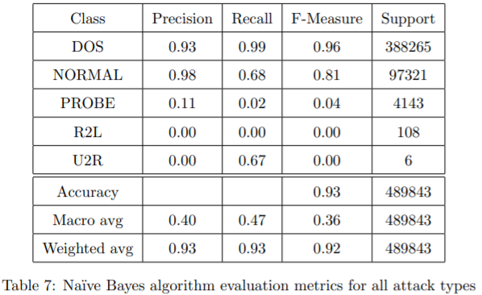
Evaluation of Naïve Bayes algorithm (5 classes)

Slide 20
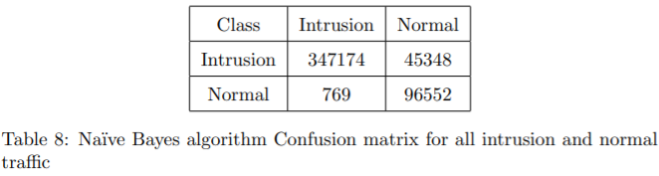
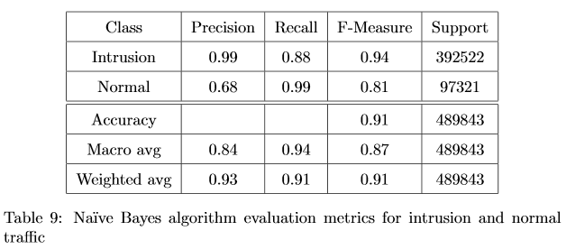
Evaluation of Naïve Bayes algorithm (2 classes)

Slide 21
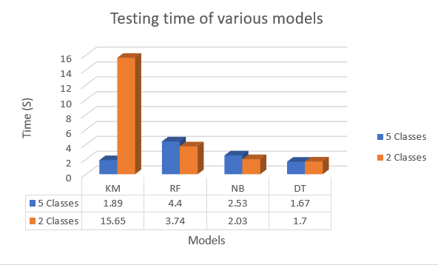
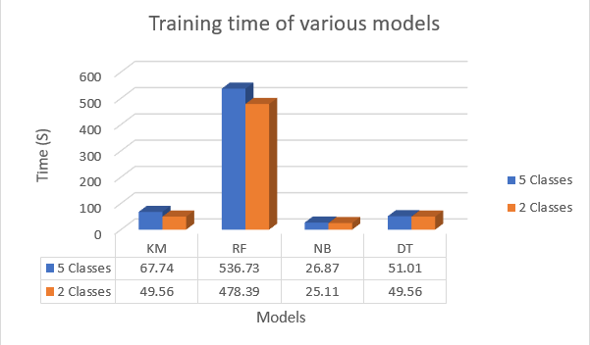
Training and Testing time Analysis
Random Forest training time and testing time is much higher than other algorithms as it generates many decision trees to choose the optimal one.

Slide 22
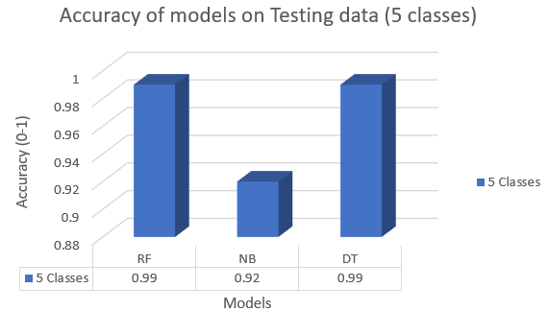
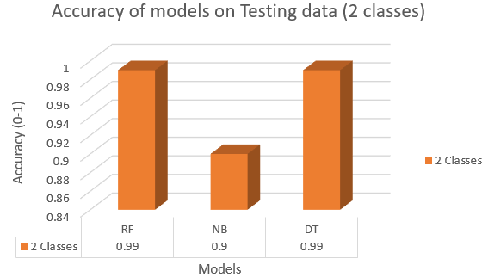
Accuracy Analysis
Accuracy – Percentage of correctly predicted values to the total values

Slide 23
Initial Remarks
An algorithm can be better in terms of precision, but it may not be best one due to false alarm rate.
No single algorithm can detect all types of attacks.
Most of the attributes have similar value so that distance between two datapoints is almost zero. (K-Means clusters training data into single cluster).
ML techniques should be used in IDS according to the network requirement.

Slide 24
Need of Deep Learning
Attacks keep continuously changing and occur at very large rate.
Due to these changing training dataset keeps changing and train the model with updated dataset.
Deep Learning techniques can learn features automatically and can detect some unforeseen attacks.
Deep learning enables machines to learn automatically from features somewhat like humans.
Can learn important features from the dataset on its own and this property make these models more powerful than Machine Learning models.

Slide 25
Deep Learning models in IDS
Recurrent Neural Networks (RNN)
Autoencoder (AE)
Deep Neural Network (DNN)
Convolutional Neural Network (CNN)
Restricted Boltzmann Machine (RBM)
Deep belief network (DBN)
Generative Adversarial Network (GAN)
Multilayer Perceptron (MLP)

Slide 26
Testing of Multilayer perceptron
Used sequential model to implement multilayer perceptron.
Used 70% data to train and 30% for testing of Multilayer perceptron.
KDDCUP99 Dataset. 70% for training and 30% for testing.
Three layers-
Input Layer- 41 Inputs
Hidden Layer- 12 nodes
Output layer – Classify data. SoftMax classifier.
Created three models with-
1 Hidden Layer
2 Hidden Layers
3 Hidden Layers

Slide 27
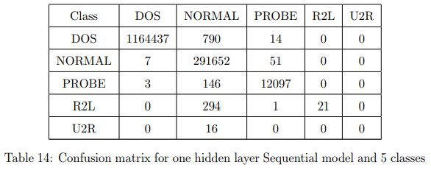
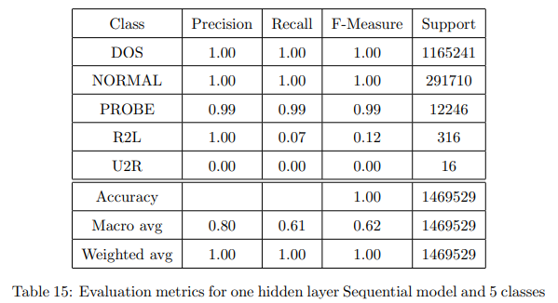
Model with one hidden Layer (5 classes)

Slide 28
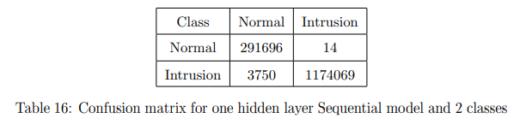
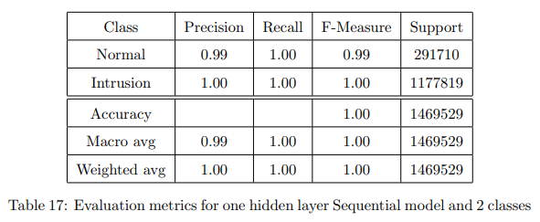
Model with one hidden Layer (2 classes)

Slide 29
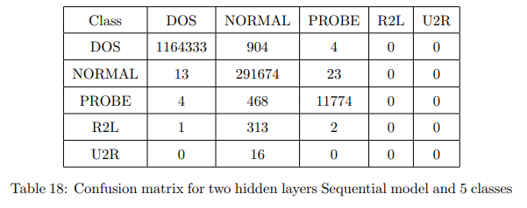
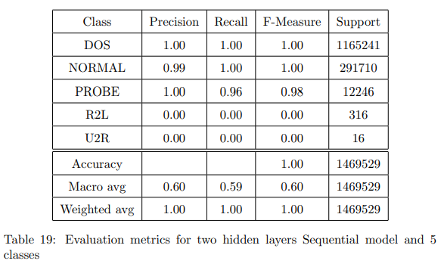
Model with two hidden Layer (5 classes)

Slide 30
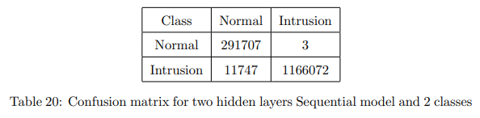
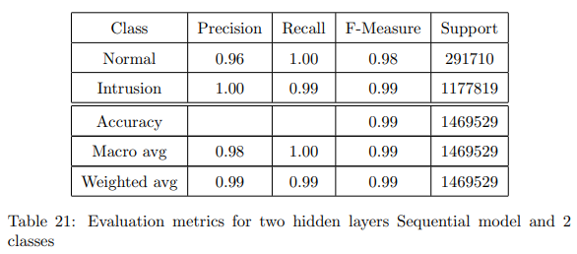
Model with two hidden Layer (2 classes)

Slide 31
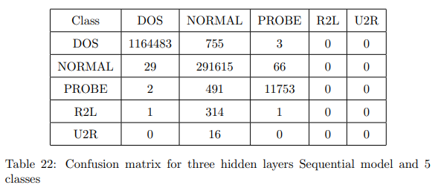
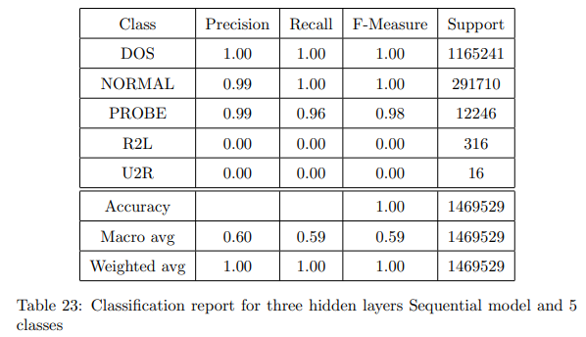
Model with three hidden Layer (5 classes)

Slide 32
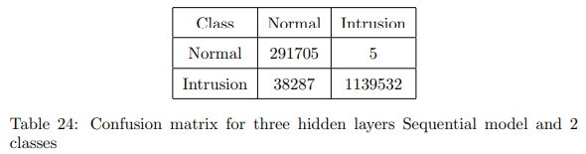
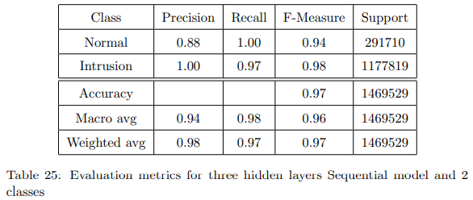
Model with three hidden Layer (2 classes)

Slide 33
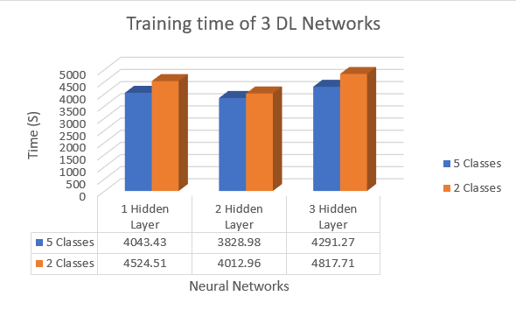
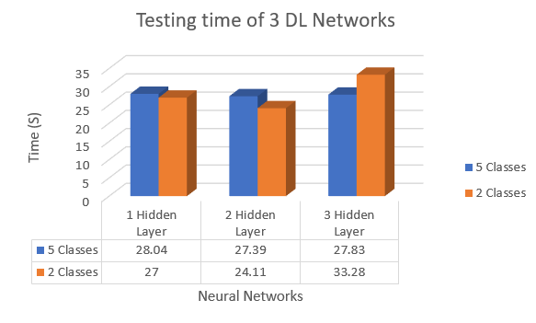
Training and Testing time Analysis
Deep learing model has large training time

Slide 34
Conclusion
Machine learning and Deep learning can be used in IDS as they learn from experience and can even detect new attacks based on past detected attacks.
A ML Algorithm can have better precision in detecting IDS, but it could be not better in terms of false rate.
Machine learning models often can detect attacks but might not detect type of attack.
DL models can solve the problems of ML models, but they require large datasets.
Better accuracy does not always mean better model. It can be due to skewed data. In spite, of having high accuracy DL models fails to detect R2L and U2R attacks.
Training time of DL models is very high.

Slide 35
Future Work
ML and DL methods can be used in IDS.
There should be dataset to verify models in current scenario.

Slide 36
References
James P. Anderson Co. Computer Security Threat Monitoring and Surveillance. Technical report, 1980.
Yongguang Zhang, Wenke Lee, and Yi-an Huang. Intrusion detection techniques for mobile wireless networks. ACM Wireless Networks Journal, 9, 04 2003
Alan Bivens, Chandrika Palagiri, Rasheda Smith, Boleslaw Szymanski, and M. Embrechts. Network-based intrusion detection using neural. Intell. Eng. Syst. Artif. Neural Networks, 12 2002.

Slide 37
References
Stefano Zanero and Sergio Savaresi. Unsupervised learning techniques for an intrusion detection system. Proceedings of the ACM Symposium on Applied Computing, 1, 12 2003.
Wenke Lee and Salvatore Stolfo. Data mining approaches for intrusion detection. 7, 02 1998.
Robin Sommer and Vern Paxson. Outside the closed world: On using machine learning for network intrusion detection. pages 305–316, 01 2010.
http://kdd.ics.uci.edu/databases/kddcup99/task.html, 1999.

Slide 38
References
Hongyu Liu and Bo Lang. Machine learning and deep learning methods for intrusion detection systems: A survey. Applied Sciences, 9:4396, 10 2019.
Zeeshan Ahmad, Adnan Khan, Cheah Shiang, and Farhan Ahmad. Network intrusion detection system: A systematic study of machine learning and deep learning approaches. Transactions on Emerging Telecommunications Technologies, 10 2020.

